Slide 1
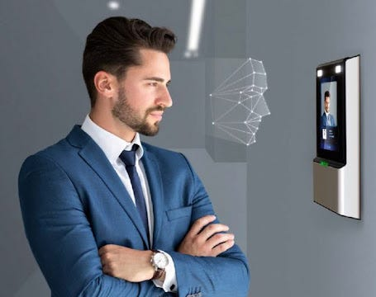
Attendance Management System Using Face Recognition
Presented By: Selina Mohapatra
Advisor: Dr. Rajvardhan Patil

Slide 2










Objective
Project focuses on automating traditional attendance methods through facial recognition technology.
Incorporate robust facial detection, alignment, and recognition processes.
The addition of employee photos to a real-time database, facilitating live viewing and updating of their total attendance.
Technical Specifications

Slide 3

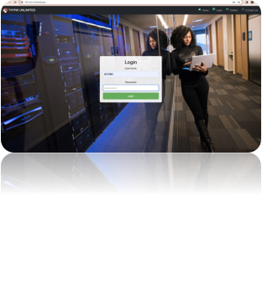
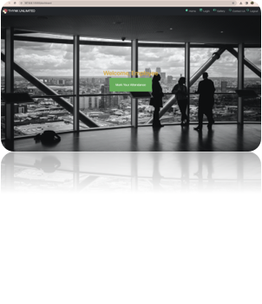
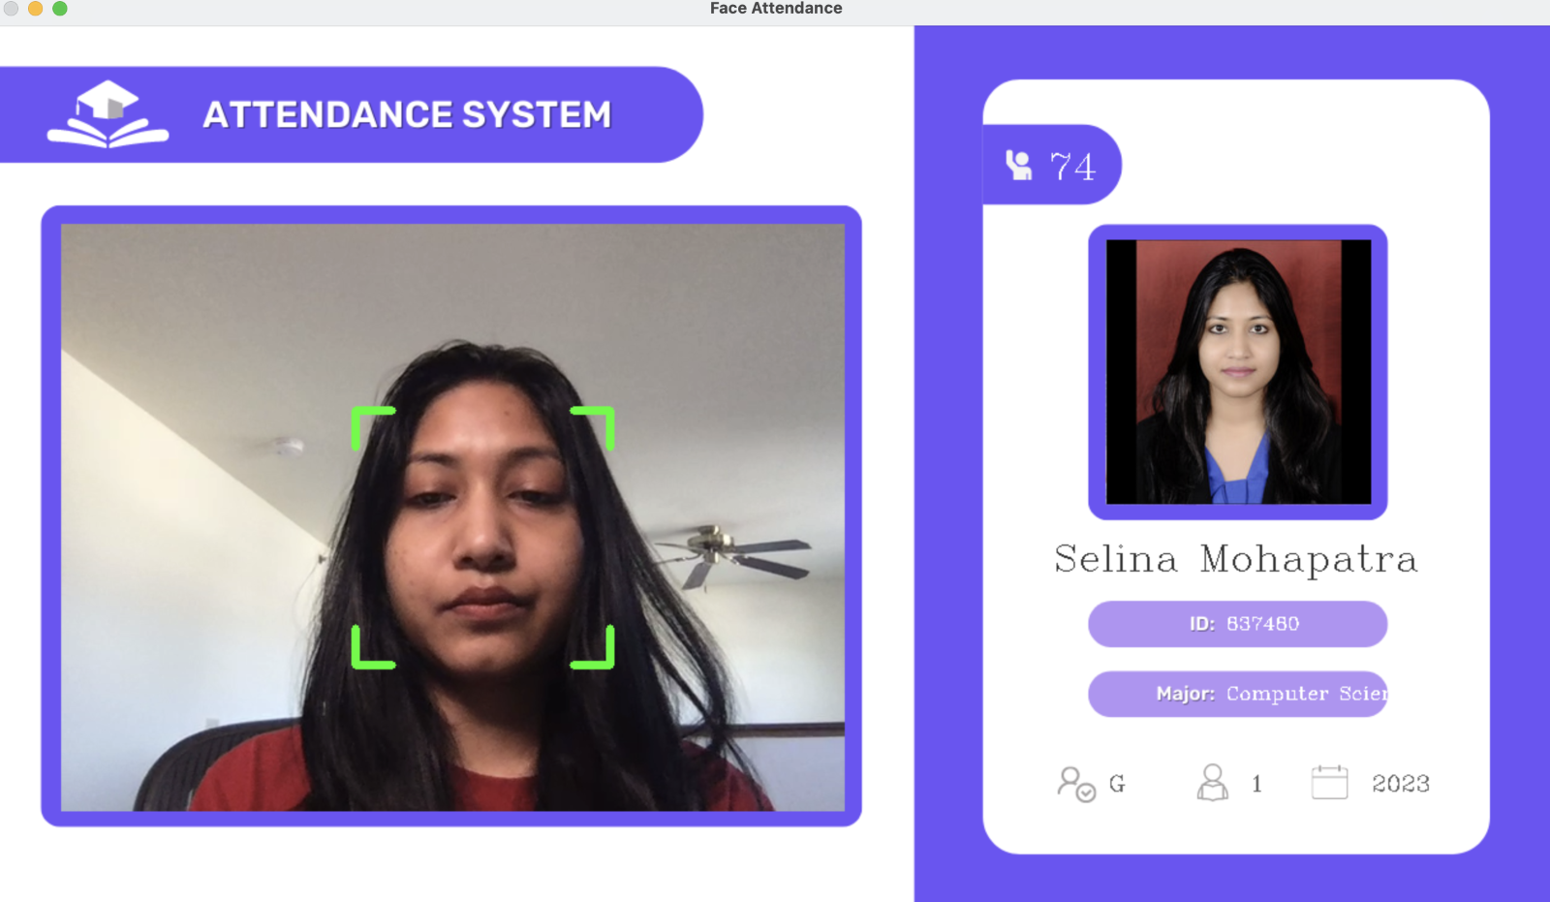
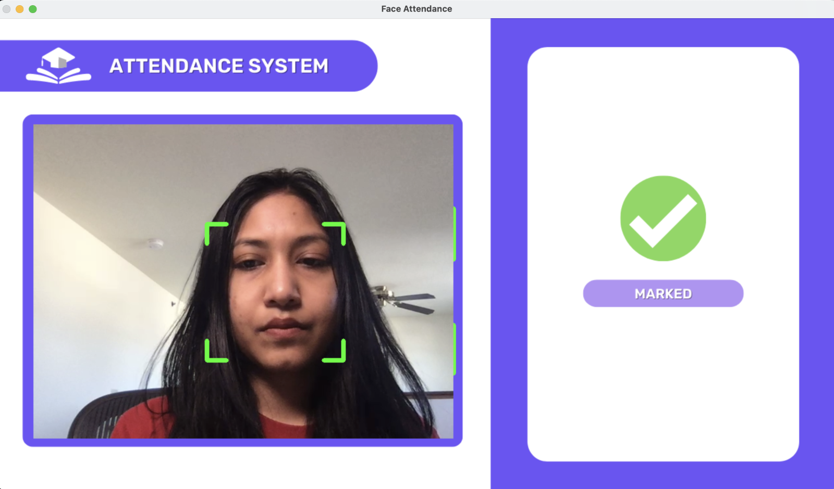
Application Showcase: Visualizing Key Screens and Features
Home Screen, offering quick access to login, gallery, and contact pages for a streamlined user experience.
2. Login screen with robust validations, ensuring users can enter and authenticate with a valid username and password for enhanced security and seamless access
3. Attendance Mark screen where user can mark the attendance with ease using the webcam-enabled screen powered by OpenCV for a seamless experience.
4. Efficiently loading data from the database upon detecting a known face, accompanied by an attendance count of 74 as depicted in the image below.
5. Status once Attendance is marked for the day.

Slide 4
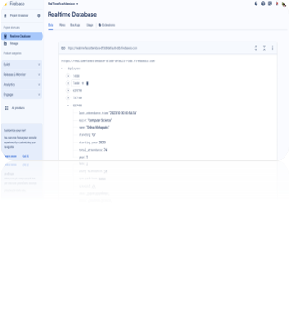
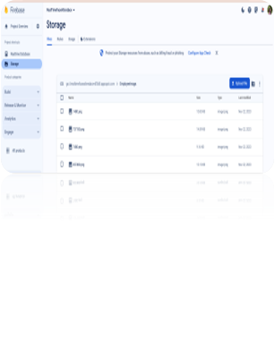
Database Insights
Conclusion and Future Endeavors
The system showcases the practical application of scalable face recognition technology, providing increased security for real-time attendance data.
Future Enhancements include the tracking of login/out times, generation of insightful reports, and integration of advanced analytics for predictive insights.

